Slide 1
Chauncey and the three games

Slide 2
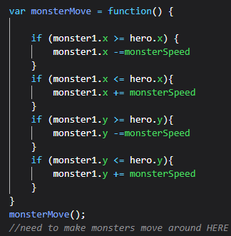
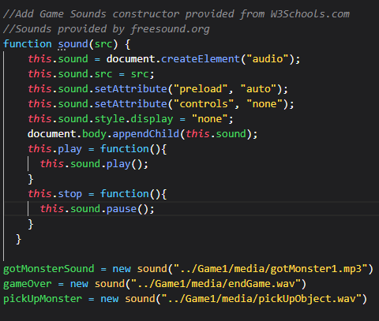
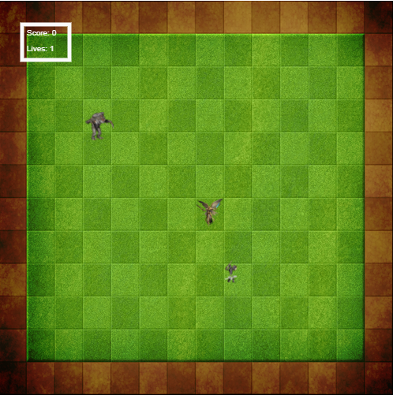
Chasing Charlie
Fun and interesting introduction into JavaScript Canvas Games
Understanding the canvas X and Y coordinates was the firsts challenge.
Ensuring characters stayed within bounds.
Player and monsters good into to constructors
Getting the sound to work using a constructor.
Future iterations include having additional levels
Really digging the Game Over Sound on this one

Slide 3


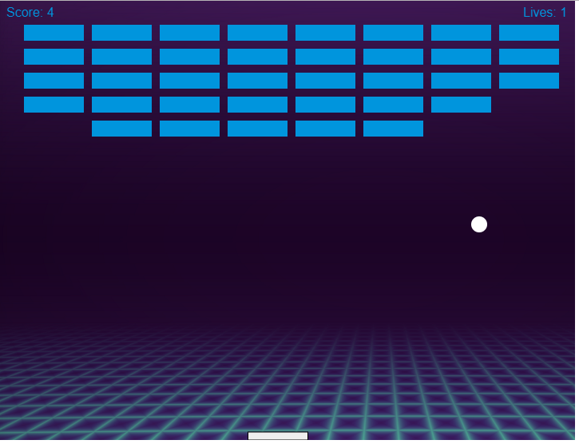
Block breaker
Wild use of nested for loops. A lot of help from MDN
Uses both mouse and keyboard
Added sound

Slide 4
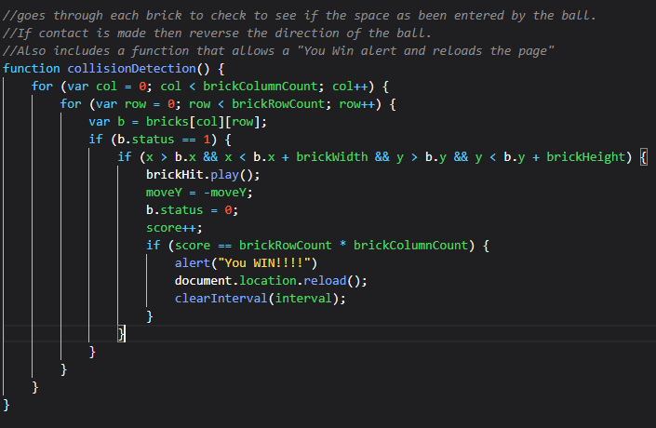
Took some getting used to……..
Was not born with this knowledge. Attended a coding bootcamp prep course that got me familiar with nesting for loops.
After understanding how those worked the physics was somewhat difficult to understand
Took info from resetting Charlie and applied here.

Slide 5
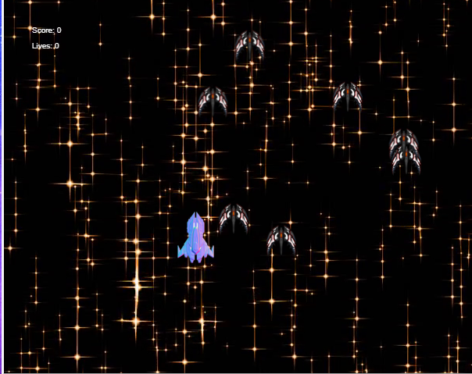
THE CU DE GRAS SPACE SHOOTER!!!!!!
THIS TOOK A LOT OF TIME TO FIGURE OUT!!!!!
Started with an incomplete tutorial and built out physics. Had to find different sources to make the canvas move. Redesigning images was a complete pain and the sound effects STILL don’t work but was able to

Slide 6
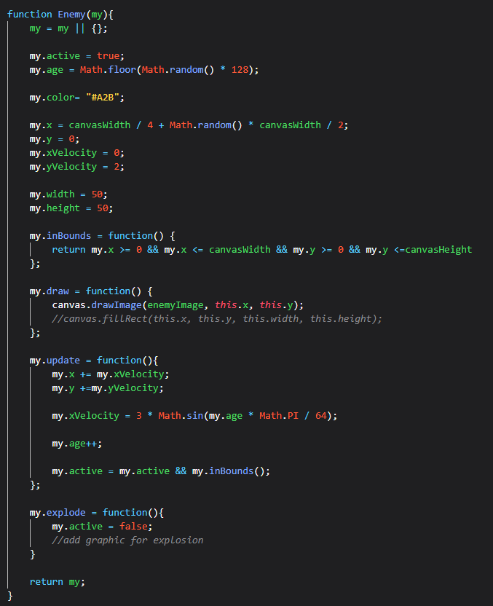
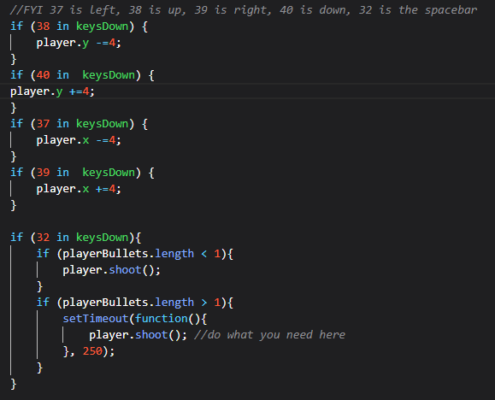
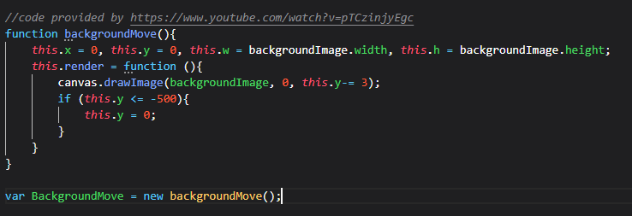

Slide 7
QUESTIONS???

